Slide 1

Manufacturing Downtime
Project
presented by:
Malek Mohammed Hamed
Azza Amen Mohamed Amen
Rana Wagih Hussein
Islam Mohamed Yassein
Mahmoud Elaraby Mohamed
Nada Abdullah Abdullah
Data Source:
Real factory logs provided by DEPI improved by AI

Slide 2
Project Team
Name | Role
Malek Mohammed Hamed | Team Leader ( data analysis & visualization)
Azza Amen Mohamed Amen | Data cleaning & Visualization
Rana Wagih Hussein | Data modeling
Islam Mohamed Yassein | Business Insights & Visualization
Mahmoud Elaraby Mohamed | Data Engineering & Project Support
Nada Abdullah Abdullah | Visualization Support & analysis
Instructor
Kareem Bakli

Slide 3
Project Overview
This project focuses on analyzing downtime across manufacturing lines to identify performance bottlenecks, reveal key factors influencing interruptions, and enhance decision‑making through Power BI dashboards.
Objectives
Analyze downtime patterns across lines, operators, and products.
Identify top downtime causes and quantify their impact on production.
Develop interactive dashboards in Power BI for management insights.
Support process improvement through data‑driven visualization and KPIs.
Scope
Covers all recorded downtime events across lines, operators, products, and contributing factors, including temporal trends

Slide 4
Literature Review
Downtime Analysis in Manufacturing Systems
Downtime analysis is a cornerstone of productivity optimization in modern manufacturing. Research shows that accurately recording, categorizing, and analyzing downtime events enables organizations to identify inefficiencies and prioritize improvement actions. For example, studies highlight the importance of breaking downtime into dimensions such as machine, line, shift, and operator to isolate recurring patterns and understand operational bottlenecks.
In relation to this project, the dataset includes detailed downtime logs (machine ID, line, shift, operator, and reason), providing a structured foundation to perform this type of multi-dimensional analysis. By aggregating downtime duration and frequency, and computing metrics, the project aligns with proven analytical frameworks used in industrial performance studies.

Slide 5
Project Plan
Phase | Tasks | Duration | Milestone
1 – Data Collection | Gather downtime logs, machine details, shift schedules, operator info, and maintenance records | Week 1 | Raw dataset collected
2 – Data Cleaning & Transformation | Handle missing timestamps, remove duplicates, standardize downtime reasons, format date/time, merge with dimension tables (machine, shift, operator) | Week 2 | Cleaned and transformed dataset ready
3 – Data Modeling | Build relationships between Fact Downtime, Dim Machine, Dim Shift, Dim Operator, and Dim Line tables; create calculated columns and DAX measures (e.g., Total Downtime, Avg Downtime, OEE) | Week 3 | Data model and key metrics established
4 – Dashboard Development | Design Power BI dashboards showing downtime by machine, line, shift, reason, and operator; integrate KPIs | Week 4 | First version of Power BI dashboard ready
5 – Review & Refinement | Validate data accuracy, enhance visuals, optimize DAX measures, apply consistent color themes, and add interactivity (filters, drill-throughs) | Week 5 | Final, polished dashboard completed
6 – Presentation & Documentation | Create project documentation (methodology, insights, recommendations), prepare presentation slides, and present findings to stakeholders | Week 6 | Project completed and presented

Slide 6
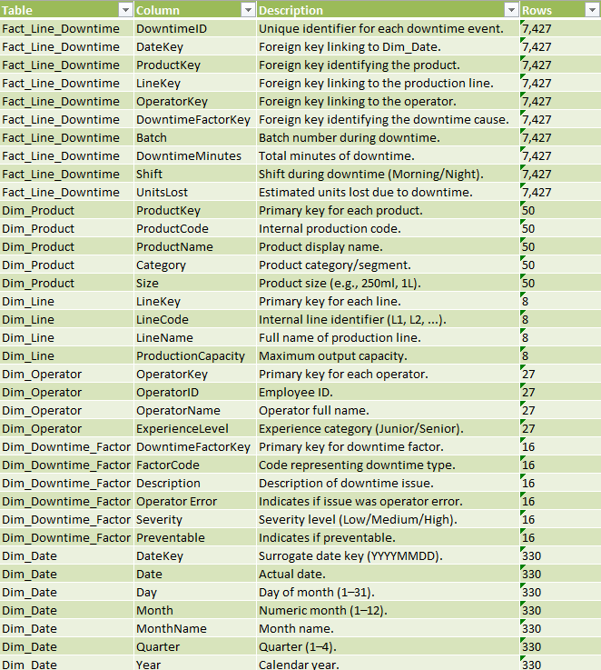
Dataset Overview
Excel file contains 6 tables:
Sheets
Fact_Line_Downtime
Dim_Product
Dim_Line
Dim_Operator
Dim_Downtime_Factor
Dim_Date

Slide 7
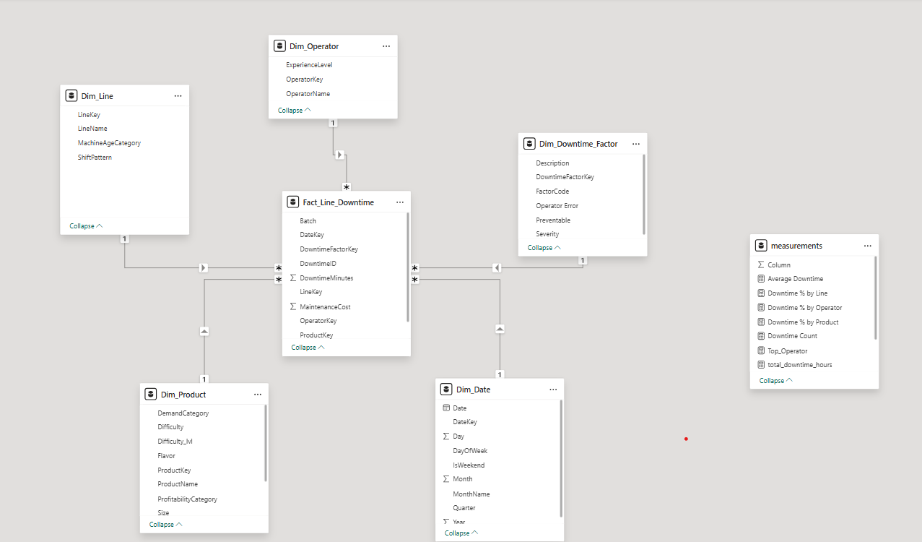
Database Design
Fact Table: Fact Line Downtime
(includes downtime duration, units lost, factor keys, etc.)
Dimension Tables:
Dim Line — Line details
Dim Product — Product information
Dim Operator — Operator details
Dim Date — Date/time attributes
Dim Downtime Factor — Cause or category of downtime
Schema
Relationships follow a Star Schema,
where Fact Line Downtime connects to all dimension tables through their keys.

Slide 8
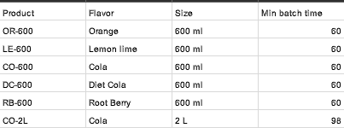
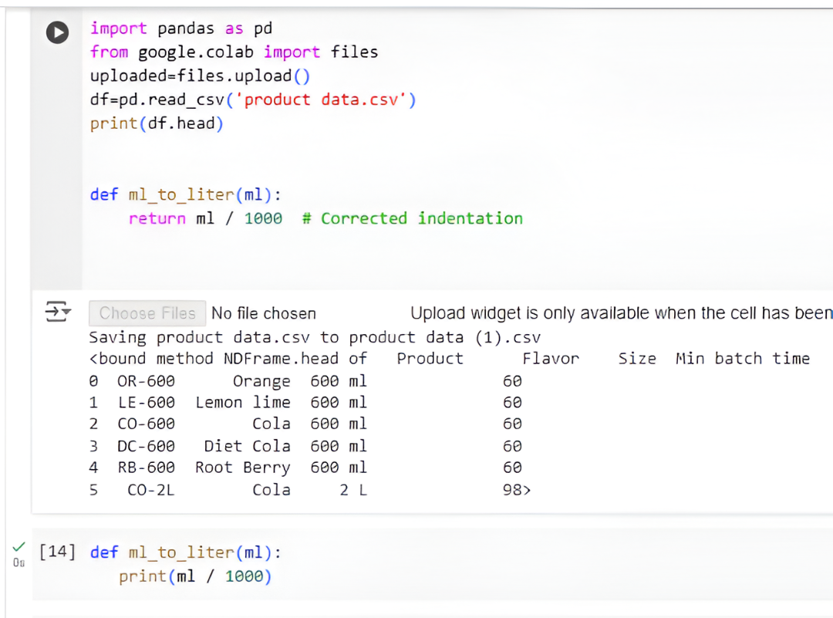
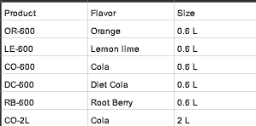
Data Cleaning
Different units in size column are detected
Process:
- Data cleaning to unite all units using python , we used the code ,"Def ml_to_liter (ml):
Print(ml/1000)" To convert any ml and L
- remove nulls
Df = df.dropna()
Output:
Structured , cleaned data with united units giving clear , accurate insights

Slide 9
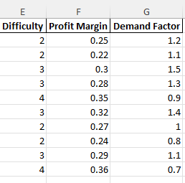
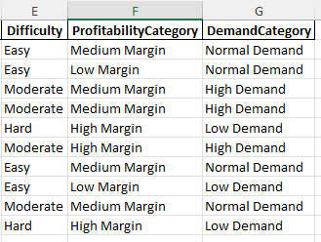
Data Cleaning
Before :
Transform Columns
Process:
Data cleaning transform the numerical columns into a meaningful categorical values
Using excel and power query
Output:
columns into a meaningful categorical values
To fit the star schema and to fit into the visualization
After :

Slide 10
Problem Statement

Slide 11
Dashboard

Slide 12
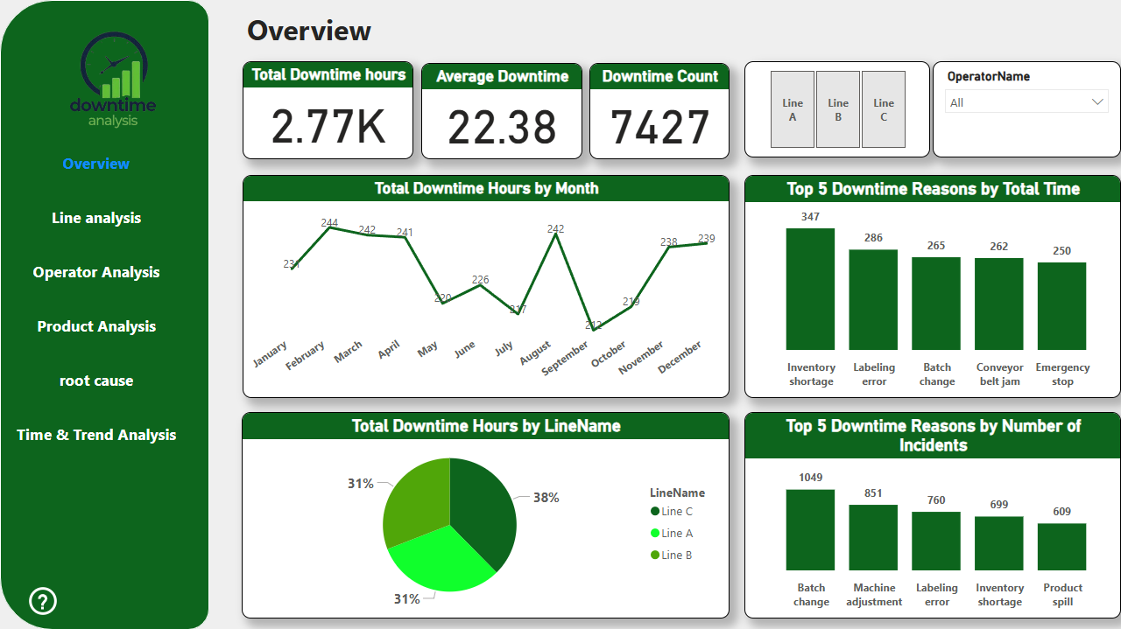

Slide 13
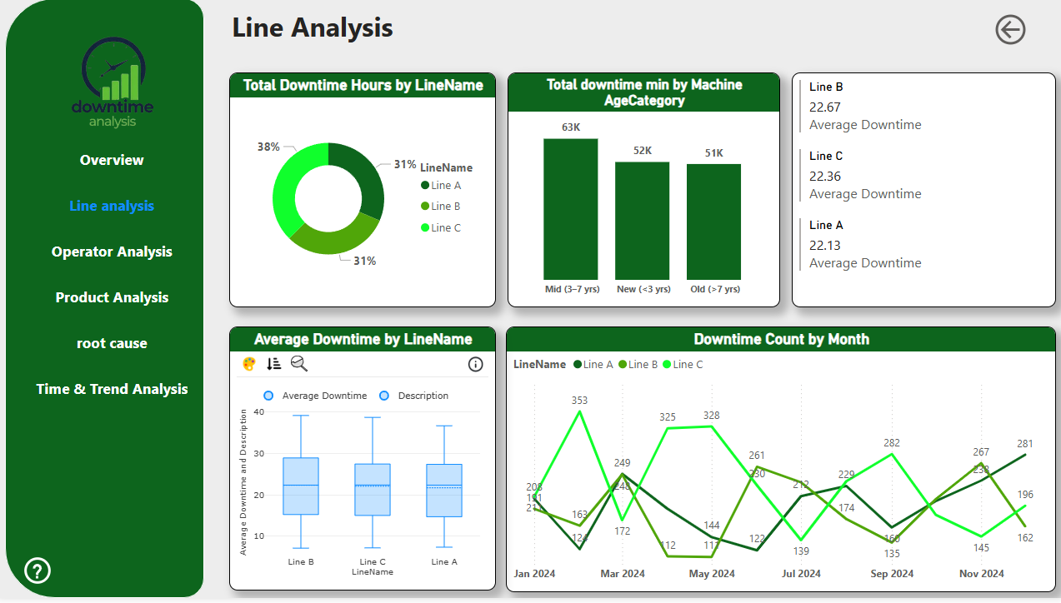

Slide 14
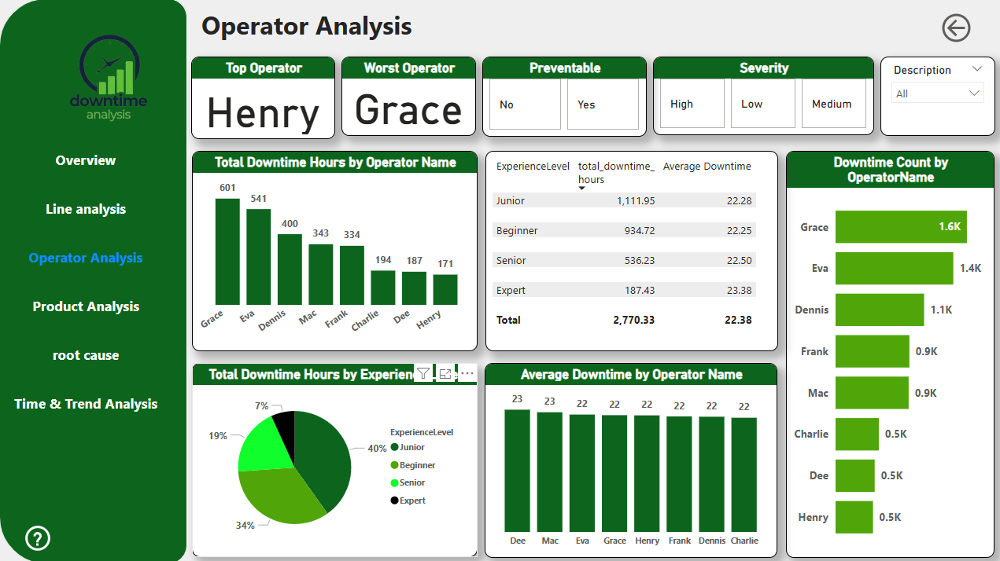

Slide 15
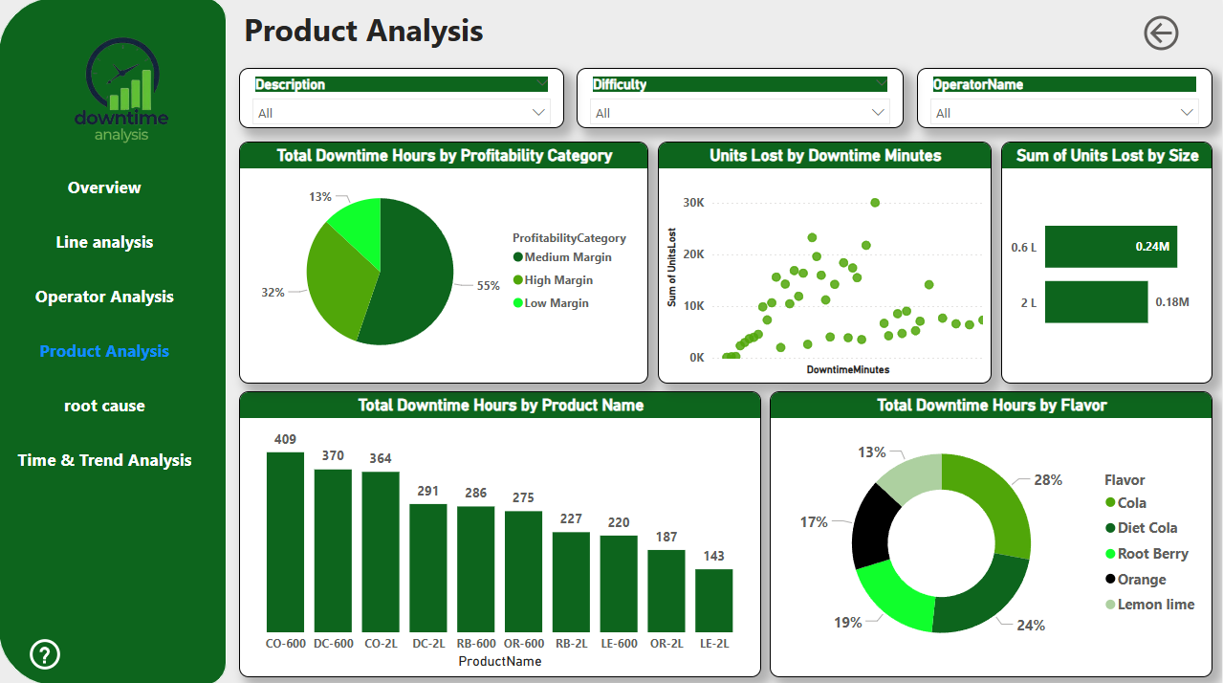

Slide 16
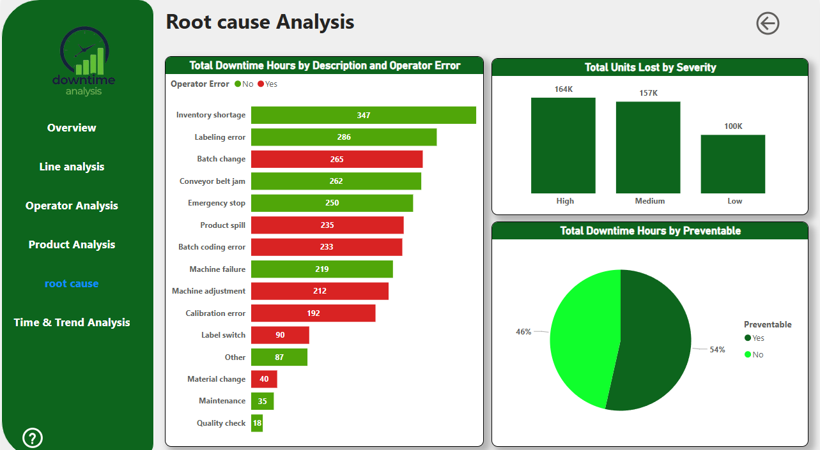

Slide 17
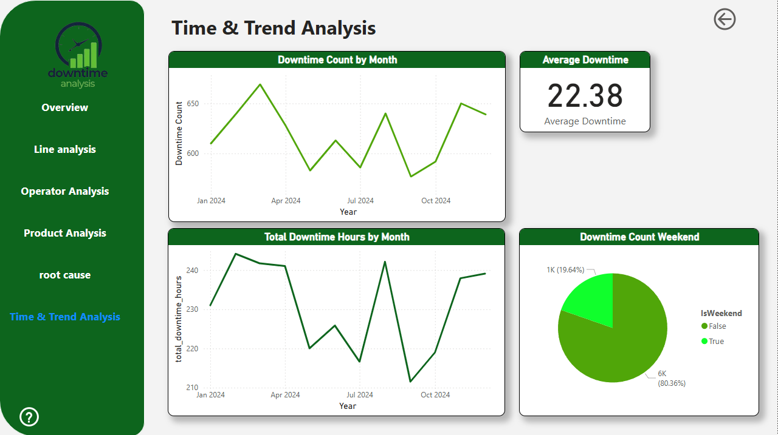

Slide 18
Deliverables
Clean and validated downtime dataset
Star schema data model in Power BI
Problem statement presentation
Interactive dashboard with KPIs and filters
Documentation and presentation slides for stakeholders
Final Outcome
A comprehensive Power BI dashboard providing management with data-driven insights into downtime performance, root cause identification, and actionable strategies for operational efficiency

Slide 19
Thank You for Your Attention

